Slide 1
Experiencing a11y
An Intro to Web Accessibility

Slide 2

Types of adaptive tools

Slide 3
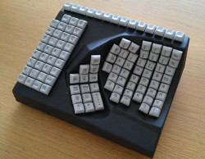

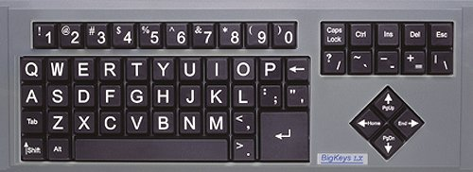



Slide 4
Switch
An adaptive switch, alters the interaction scheme between the user and the device making a previously inaccessible method (the buttons are too small and inaccessible for persons with poor motor skills) accessible by using a movement pattern or skill that the person with a disability can more easily perform. *www.c3schools.org/MHEC/WebCT/Adaptive_Switches.doc

Slide 5
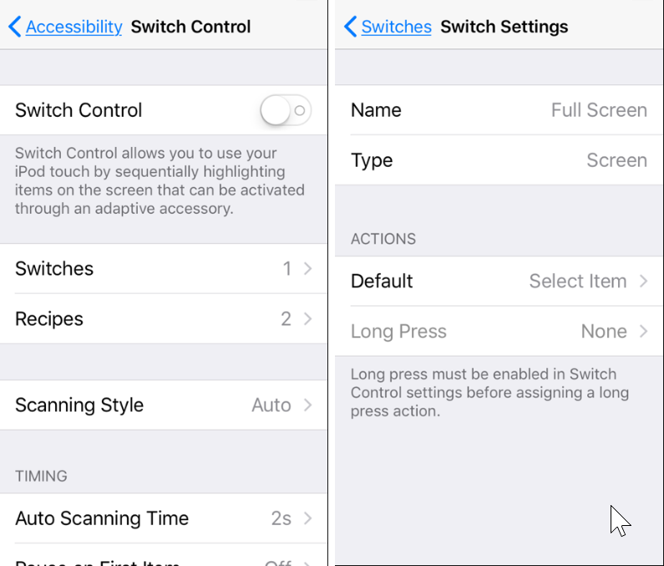
Switch for iOS devices
Settings > General > Accessibility > Switch Control
1.) Tap Switches
2.) “Full Screen” should be set up by default
3.) If you don’t see this, tap on “Add New Switch”.
Under “Source” select Screen
Select “Full Screen”
Under actions, select “Select”
4.) Select “Auto scanning” as the scanning style
5.) Set 2s as Auto Scanning Time
To turn off switch: Click home button or power button 3 times

Slide 6
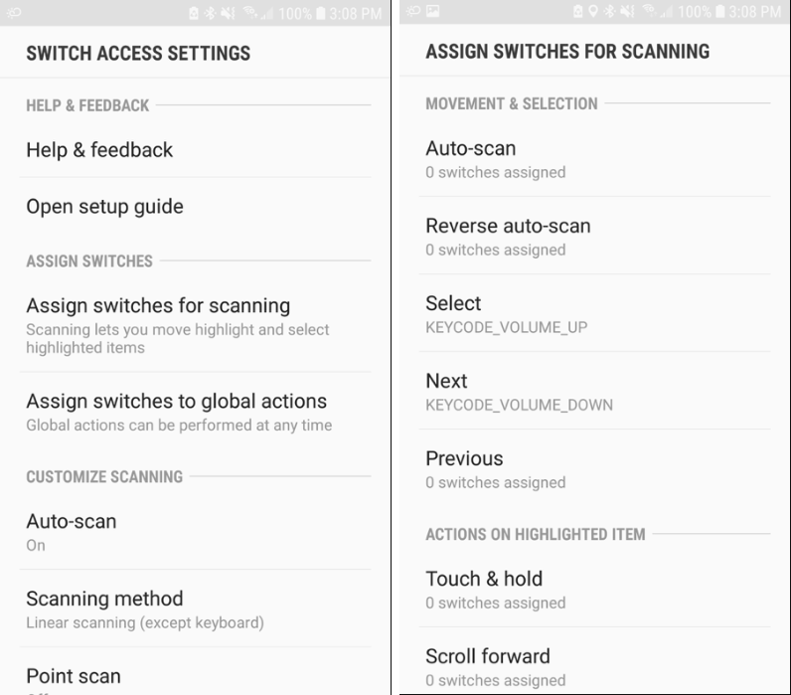
Switch for Android Devices
Settings > Accessibility > Switch Access > Settings
1.) Turn “Auto Scan” off
2.) Turn “Point Scan” on
3.) Click “Assign Switches for Scanning”
Tap “Select” and press the volume up key then “Save”
Tap “Next” and press the volume down key then “Save”
4.) Return back to the “Switch Access” Menu and toggle “Use Service” on

Slide 7




